Slide 1

01.Robot

Slide 2
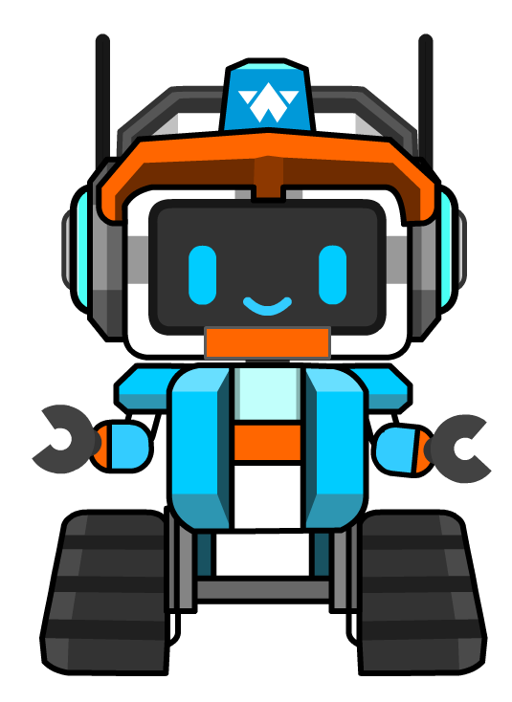
1. Introduction
With the rapid development of human science and technology, robot technology has received more and more attention as a cutting-edge science.
A country's industrial level is directly measured by the number of robots, so learning robot courses also appears important.
So what is a robot?

Slide 3
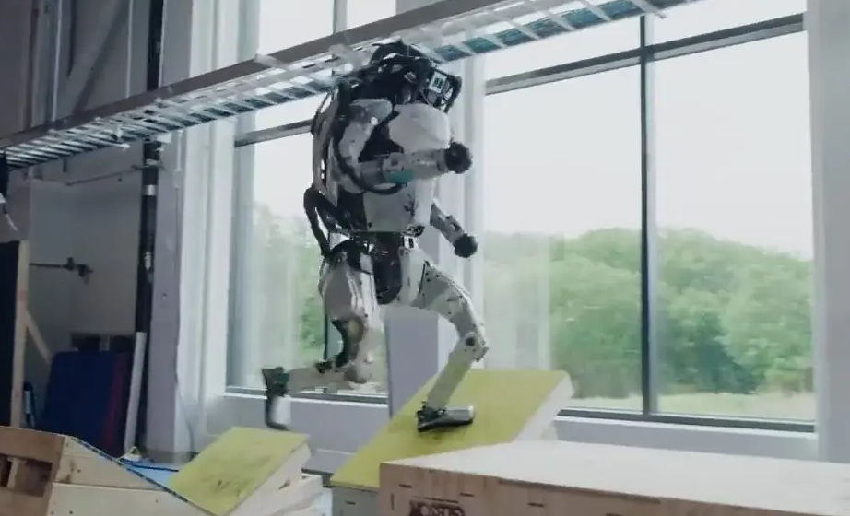
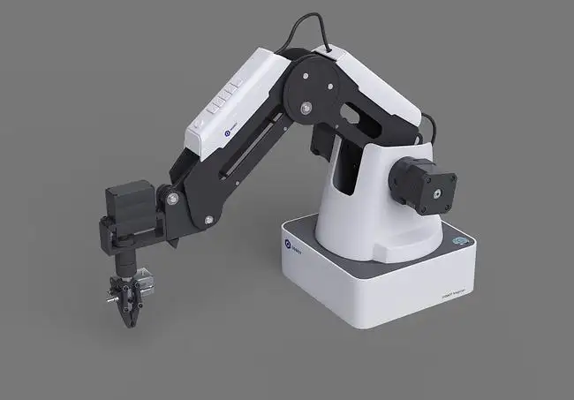
humanoid robot
1. Introduction
humanoid robot
industrial robot

Slide 4
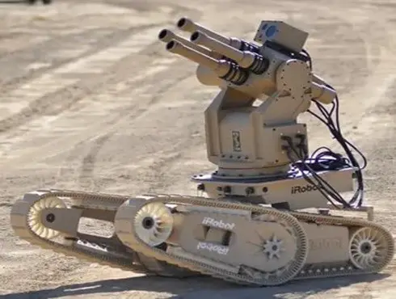
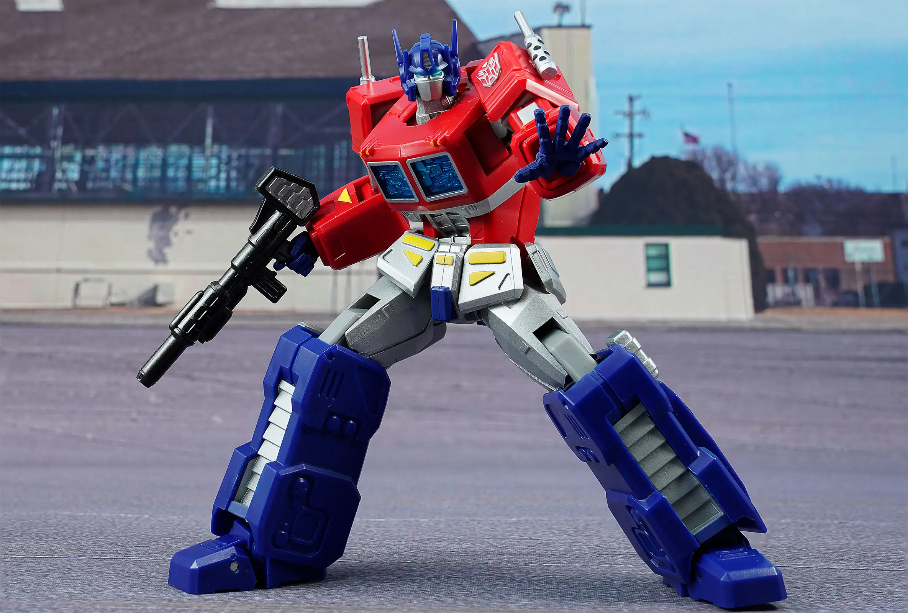
humanoid robot
1. Introduction
battle robots
and...

Slide 5
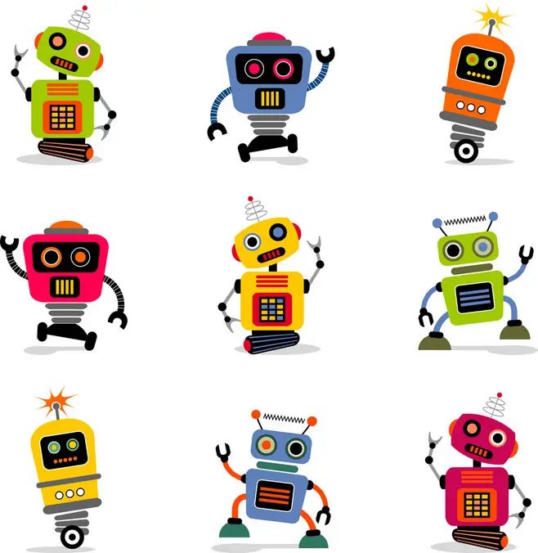
2.Exploration
How do you define a robot?

Slide 6

2.Exploration
A robot is defined as a mechanical device that performs its work automatically.
Just like humans, robots have the ability to sense information, process information, and output information.
Of course, humans need to program it in advanced.

Slide 7
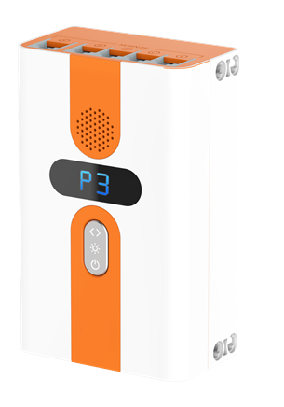
2.Exploration
Today we are going to start our robotics course, using the AI Module series of robots. It is also a very intelligent robot, we can make a lot of fun things with it, now let's go into the wonderful world of robots!
Let's get familiar with the robot's "brain" - the controller.

Slide 8
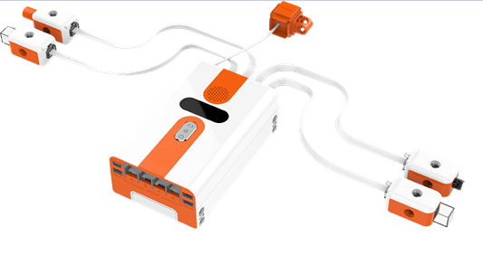
2.Exploration
The controller has two buttons and a LCD screen, which receives sensor information through a cable.
After program processing, the controller directs the robot's actuator to respond accordingly.

Slide 9
2.Exploration
There are interfaces at the top and bottom of the controller, and they are named as interfaces 1-5 and A-D to distinguish them.
Ports 1-5 are used to connect various sensors.
Ports A-D are used to connect various actuators.

Slide 10
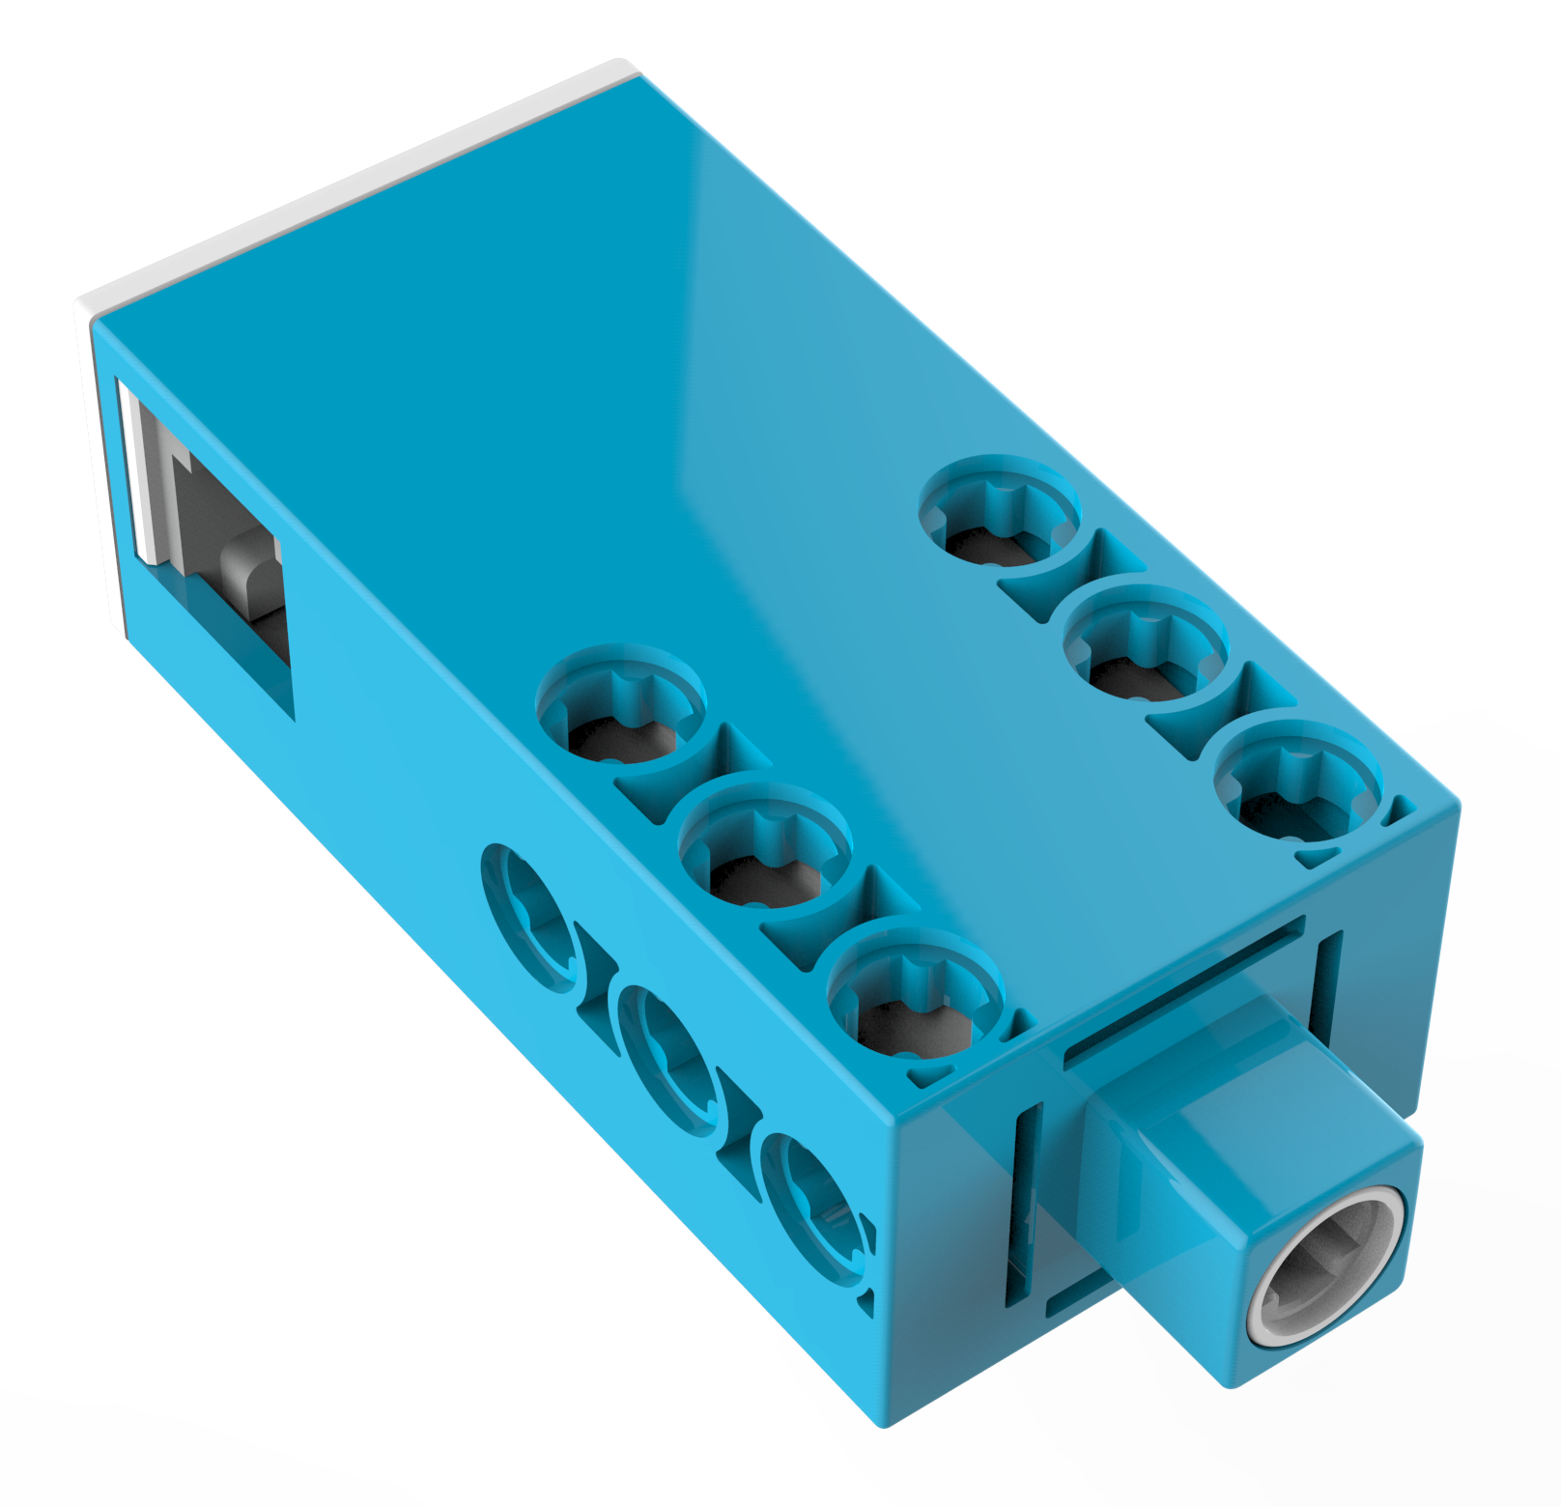
2.Exploration
Now let's recognize that we need to learn the first actuator ----- closed loop motor!
We can call it a motor for short.

Slide 11
2.Exploration
The closed-loop motor is the actuator we use to output power.
After electrification, the closed-loop motor outputs power in the form of circular motion.
When we manually drive the motor (turning the conductor to cut the magnetic induction line), electricity can be generated.

Slide 12
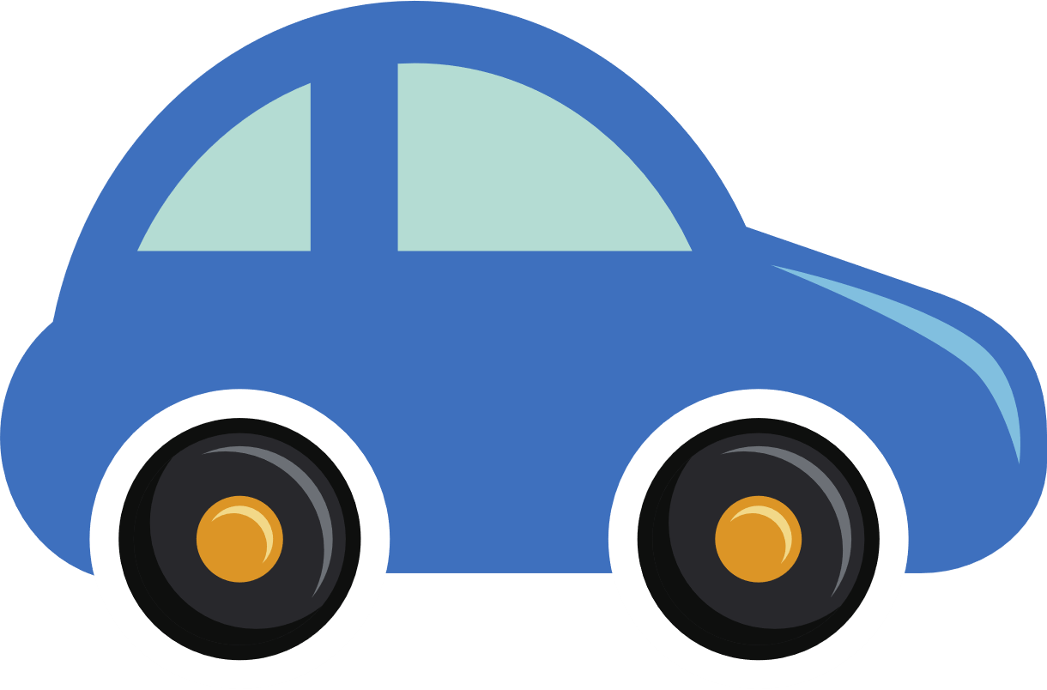
3. Construction
Now let's start to design a power generation car!

Slide 13
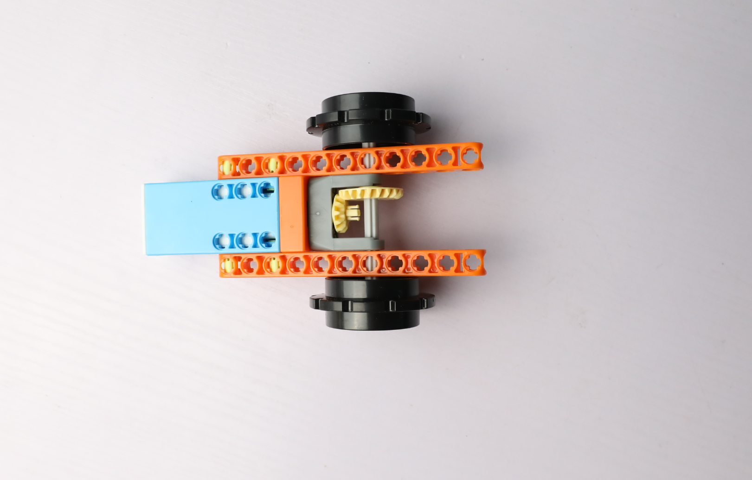
3. Construction

Slide 14
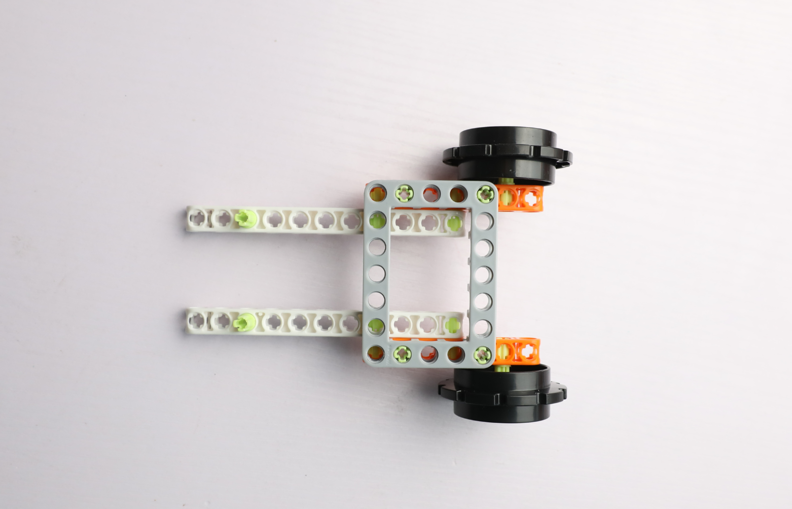
3. Construction

Slide 15
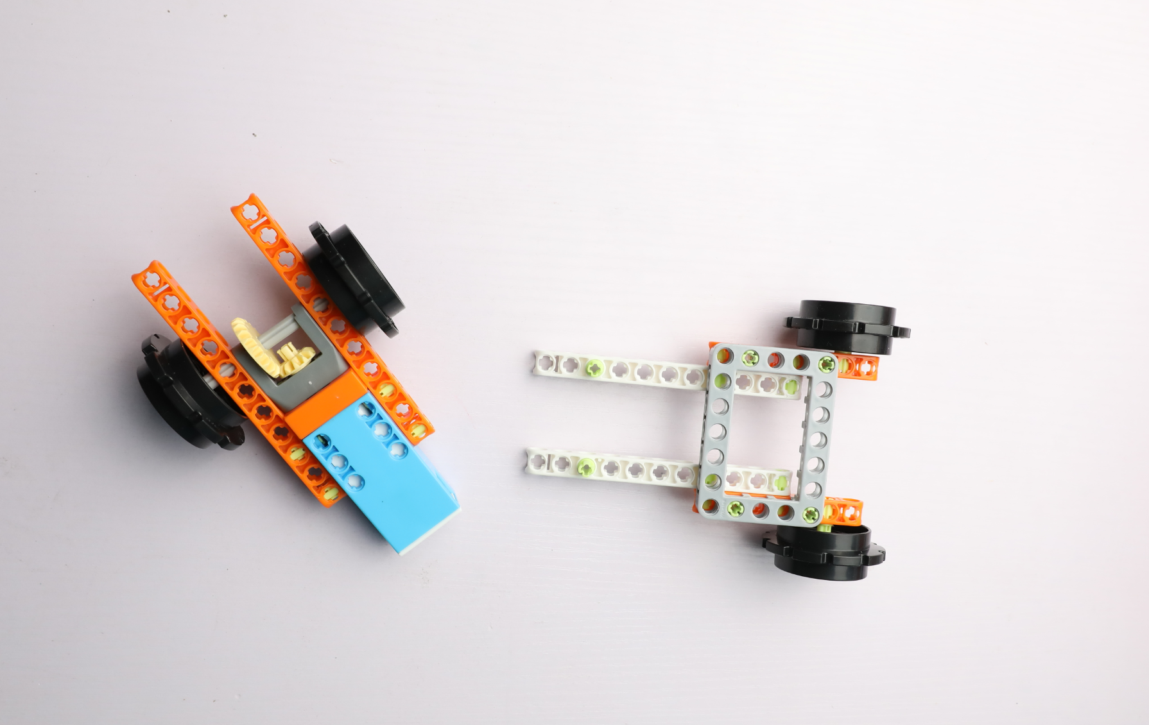
3. Construction

Slide 16
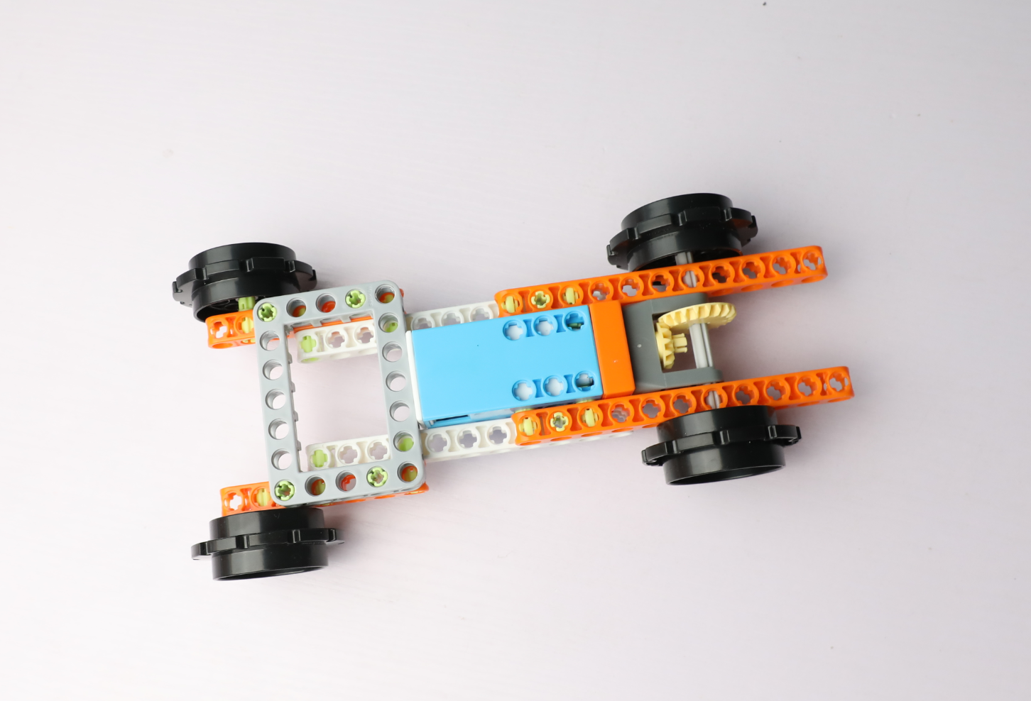
3. Construction

Slide 17
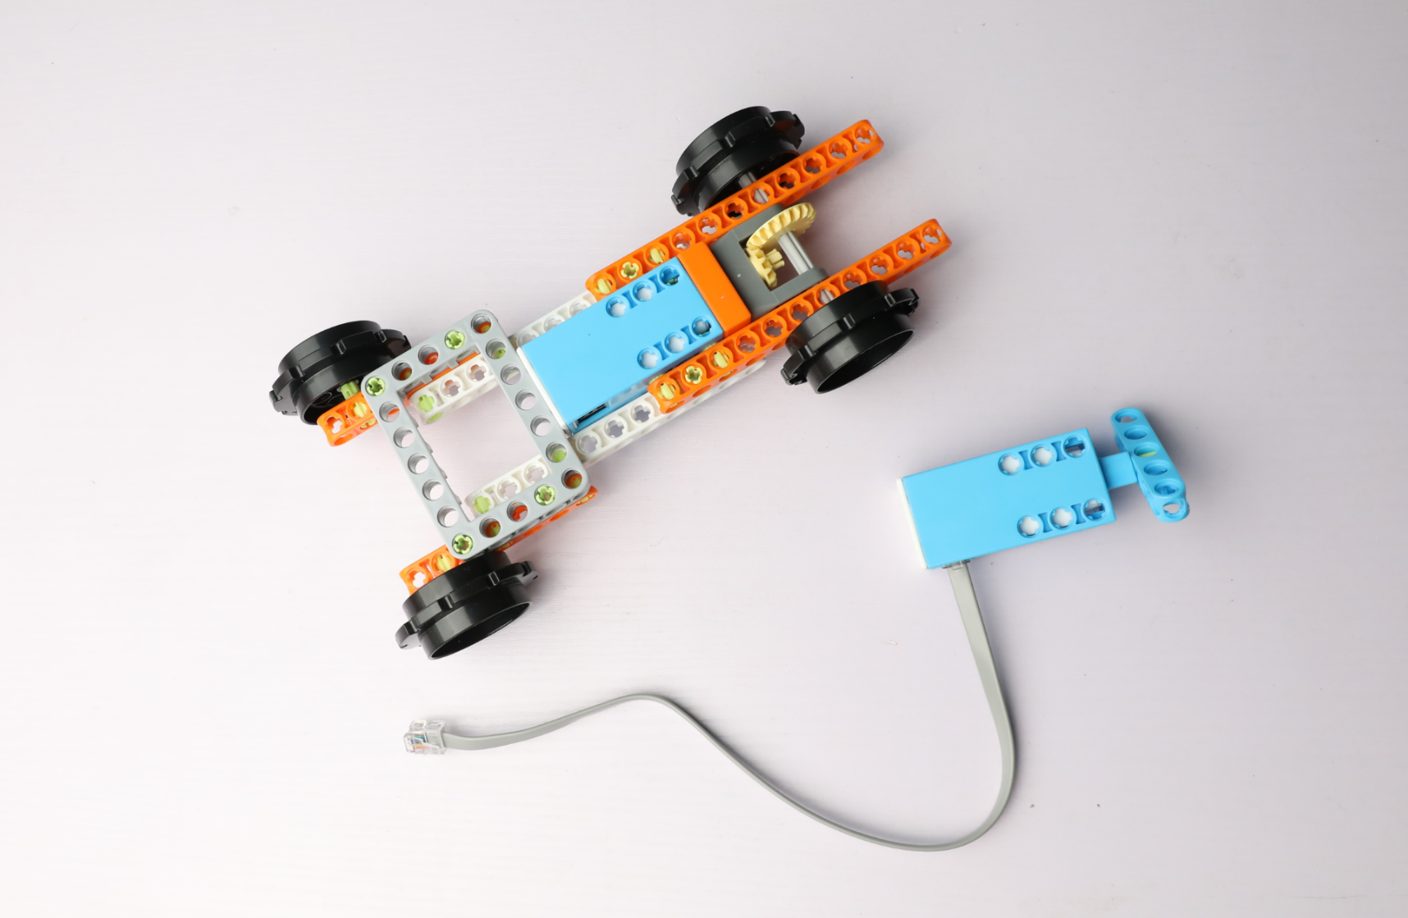
3. Construction

Slide 18
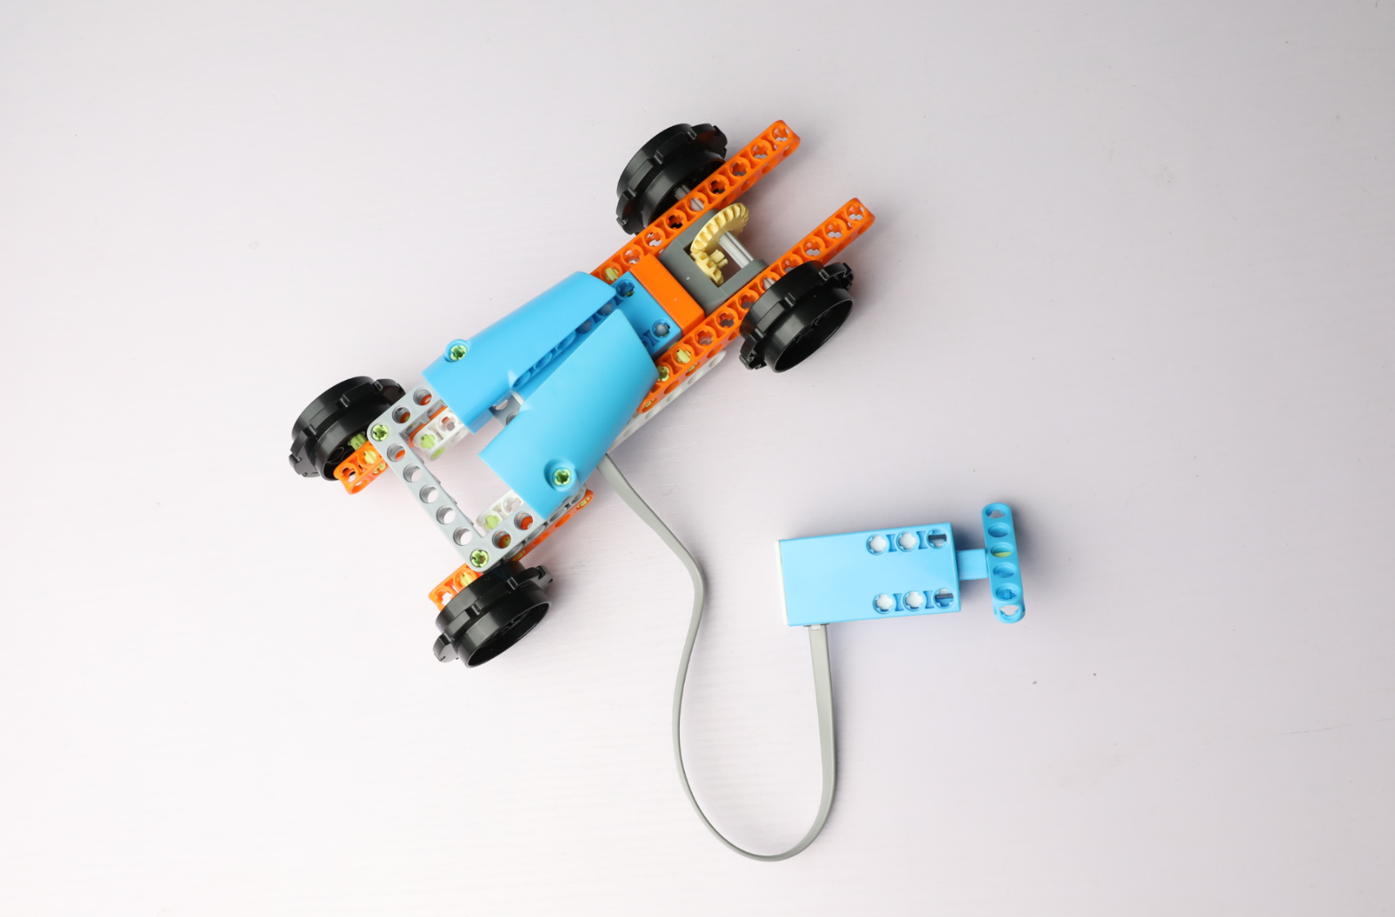
3. Construction

Slide 19
4.Test
Turn the handle on the motor hard and see what happens.

Slide 20
控制器上的接口除了传递信息还具有什么作用？
5.Evaluation
What else does an interface on a controller do besides pass information?

Slide 21

控制器上的接口除了传递信息还具有什么作用？
5.Evaluation
It also provides power for actuators and sensors.

Slide 22
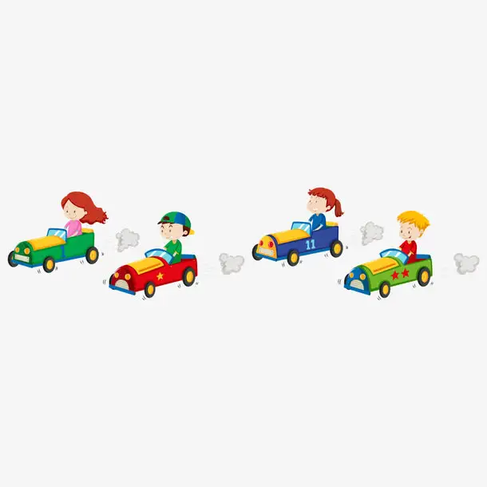
6.Show
Now we use the hand - powered car to have a race!

